Slide 1
Federal Financial Support for Heritage Places in Budget 2019 are Needed Now:
Acting on ENVI Report
Preserving Canada’s Heritage:
The Foundation for Tomorrow
(December 2017)

Slide 2
Who you are – your name and organizational logo here!
Who you are
The organization you represent
Your mission
Your membership – size and interests

Slide 3
ENVI Committee Report – Preserving Canada’s Heritage: The Foundation for Tomorrow (December 2017)
Hon. Catherine McKenna
Minister of Environment and Climate Change
Notes:
Which Minister is responsible for heritage buildings and landscapes?
At the federal level, leadership for heritage buildings and landscapes is the responsibility of the Parks Canada Agency, which reports to the Minister of Environment and Climate Change. The Minister of Canadian Heritage does not have a responsibility for heritage buildings and landscapes. This distinction at the federal level can lead to confusion contributes to heritage places falling through the cracks.
Historic federal study – Report from the House of Commons Standing Committee on Environment and Sustainable Development –
Preserving Canada’s Heritage: The Foundation for Tomorrow
Report tabled on December 6, 2017.
A historic, milestone report - The first federal study of heritage places in Canada in a generation. Its recommendations present an expanded new role for the federal government in Canada’s historic places, one that puts its work on an equal footing
Key Recommendations? - Strengthening Heritage protection for Federal heritage properties
Recommendation 11 – Establishing a tax credit for the restoration and preservation of buildings listed on the Canadian Register of Historic Places;
Recommendation 10 – Funding for the National Cost-Sharing Program for Heritage Places to a minimum of $10 million per year;
Recommendations 15 & 17 – Supporting an Indigenous-led initiative to protect and preserve places important to them, including the legacy of residential schools;
Environment Minister Catherine McKenna now has 120 days to respond.

Slide 4
Summary: ENVI Report – Heritage Sector’s Priorities for Much Needed Federal Action
Measures that would encourage private sector investment in heritage places
Recommendation 11 – Establish a tax credit for the restoration and preservation of heritage properties
Recommendation 8 – Requiring all federal departments give preference to existing buildings
Measures that help fund the efforts of Indigenous Peoples, charities and not-for-profits to save and renew heritage places
Recommendation 15 & 17 – Support an Indigenous–led initiative to protect and preserve places important to them
Recommendation 10 – Establish consistent ongoing funding of at least $10 million per year for the National Cost-Sharing Program for Heritage Places
Notes:
The recommendations noted here are those recognized as key by members of Canada’s heritage sector.
Additionally, the bi-partisan Standing Committee on Environment and Sustainability recognized the positive social, economic, and environmental impact of conserving heritage places and outlined a course of action for the federal government through the recommendations set forth in Preserving Canada’s Heritage: the Foundation for Tomorrow. Your role is to make these recommendations a priority within your party and push for their inclusion in budget 2019.

Slide 5
Budget 2019 Recommendations Pending Future Action on the ENVI Report - Part 1
Renewal and Expansion of Parks Canada’s National Cost-Sharing Program for Heritage Places:
$33 million over 3 years in matching grant funding for National Historic Sites, Heritage Lighthouses, and Heritage Railway Stations
$35 million over 3 years to attract corporate investment and bring new productive uses to revenue-generating commercial heritage properties
An additional multi-million dollar fund for heritage places of significance to Indigenous Peoples.
Notes:
Renewal and Expansion of Parks Canada’s National Cost-Sharing Program for Heritage Places:
$33 million over 3 years in matching grant funding for National Historic Sites, Heritage Lighthouses, and Heritage Railway Stations – with an estimated leverage effect of 5 times the federal contribution;
$35 million over 3 years to attract corporate investment and bring new productive uses to revenue-generating commercial heritage properties – with an estimated leverage effect of at least 5 times more in private investment, and the creation of an estimated 2000 jobs;
An additional multi-million dollar fund for heritage places of significance to Indigenous Peoples. The Federal Government’s response to the Truth and Reconciliation Commission of Canada’s Call to Action 79 must not fail to include substantial funding to support the efforts of Indigenous Peoples to save and renew their heritage places, and commemorate their contributions to Canada’s history.

Slide 6
Budget 2019 Recommendations Pending Future Action on the ENVI Report - Part 2
Funding to create a transformative culture of philanthropy for historic places, to encourage public and corporate donations to heritage places that matter to Canadians, including Indigenous Peoples:
$6 million to build the capacity of charities and not-for-profit organizations to raise funds and forge corporate partnerships for community-led projects
$2 million for national crowdfunding competitions to spur community philanthropy for heritage places.

Slide 7
Non-Profit and Indigenous Heritage Places – Overcoming the Challenges
Provinces and Municipalities – Grants and other measures are not enough to tip the tide.
National Cost-Sharing Program for Heritage Places - Needs renewed Federal funding.
Support is needed for Indigenous–led initiatives to protect and preserve places important to them.
Notes:
Current grant situation:
Not all provinces provide grants
Municipal governments provide grants but they are often modest and do not modify behavior
Current grants landscape.
Grassroots groups and charities face extreme challenges to find seed funding to kick-start renewal of historic structures and sites. Competition for grant funding is scarce: For example the Canada 150 Community Infrastructure Program requires not for profits with modest heritage projects to compete with projects for arenas, gymnasiums, pools and sports fields. Earlier this year Fed Dev Ontario's website reported 1100 applications requesting more than $260 million in funding for their first intake – almost 6 times more than the available funding.
NGOs and charities have the vision to use these places for social enterprises or cultural infrastructure, to attract tourism and anchor culture and identity. But seed funding is often the missing ingredient.
Further the advertised eligibility was later increased to include local roads, airports and waste management, creating an even greater competition for these funds.
National Cost-Sharing Program for Heritage Places
Provide a predictable go-to source of federal matching funds for the renewal of heritage properties owned by non-profits and charities: The only federal funding program DEDICATED to historic places is the National Cost-Sharing Program for Heritage Places, which encompasses National Historic Sites, federally designated railway stations and lighthouses. The funding available has ranged from $0 for many years, to as little as $1million per year. The current $10 million per year made available for last year and the current year is an important piece of the puzzle – but there are more than 700 properties eligible, many have been under funded for decades, and $10 million per year is a drop in the bucket – the program is already fully oversubscribed. By contrast, the Cultural Spaces Canada Fund recently received $84 million a year for two years.
These kinds of programs address some of the shortfalls of a system based solely on tax credits, which do not benefit tax-exempt groups such as NGOs.

Slide 8
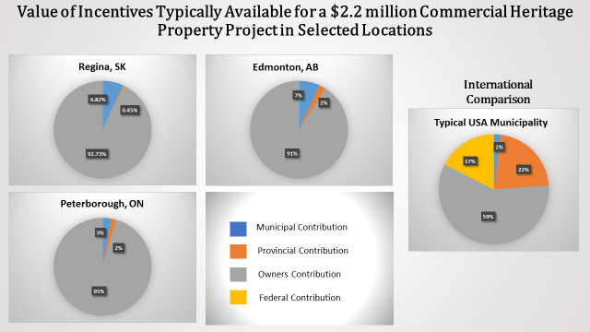
Commercial Heritage Properties – Overcoming the Challenges
Notes:
Here you can see a sampling of incentives offered in a number of Canadian cities. Each of these show the best case scenario for grants or tax breaks. However, these incentives are often limited by annual budgets for grant programs and as such these already minor incentives can be even lower in value.
The incentives currently offered are not game-changing or behavior-changing. What we commonly see under these programs is some help for already willing owners, but little that would incentivize a broader scope of actors (be it businesses or individuals) to undertake conservation projects of heritage places.
The Canadian federal government does not currently play a role in these incentives. This, however is not the case in the US. In the example of Dallas, Texas on the right, one can see a clear and substantial contribution from the US government which greatly impacts the overall value of the incentives. This American model has proven incredibly effective on a number of fronts.

Slide 9
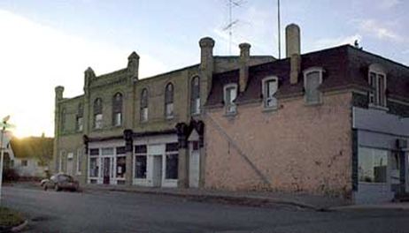
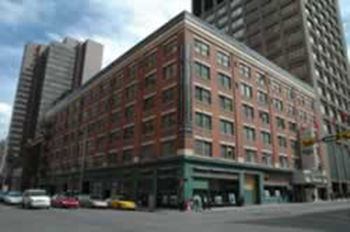
Historic Places Investment Yields Economic Dividends
The former Commercial Heritage Properties Incentive Fund (CHPIF) (2003-2008)
A federal program designed to test the appetite for a program similar to American program the saw $21.5 M in federal contributions leverage 8 times in private investment ($177 M)
McNaughton Building,
Moosomin, SK
Notes:
In a Canadian pilot program designed to ‘test’ the appetite and benefit of a potential tax incentive, the former Commercial Heritage Properties Incentive Fund (CHPIF) offered financial incentives to attract developers to rehabilitate historic buildings.
The results were impressive: total of $21.5 million in federal contributions spread across 49 projects leveraged more than 8 times that amount in private sector investment ($177.2 million) and gave empty, derelict buildings vibrant new uses.
Some examples of the success of the program are:
Lougheed Block, Calgary
Project cost - $13,334,395
CHPIF - $1,000,000
City of Calgary (Tax Abatement) - $3,400,000 over 15 years
Alberta Historical Resources Foundation - $100,000
McNaughton Building, Moosomin, SK
Project cost $75,000; CHPIF contribution $15, 012
Costs to Federal Government of an ongoing incentive program
The tax revenue cost projections do not explicitly include the tax revenue offsets that would arise from greater economic activity associated with historic property rehabilitation projects. The economic benefits and tax revenues have proven to be very significant in the United States.
This program demonstrated that there is a real and tangible benefit to government financial incentives for heritage properties. However, it is also important to consider, and address, the challenges that NGOs and Indigenous heritage places face with respect to rehabilitation and conservation.

Slide 10
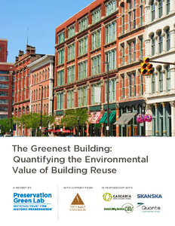
Why Do Heritage Places Matter?
Local Identity
Job Creation
Economic Impact
Help Fight Climate
Change
Notes:
Heritage places are a resource that often goes untapped or underutilized. Found in urban centres, small towns, and remote regions, they offer great opportunities as building blocks for regional development, cultural/tourism activity, social infrastructure and the creation of green jobs.
Heritage Places Matter (locally and nationally) - From the humblest to the grandest, heritage buildings tell the story of Canada better than any textbook – they represent our country in its beauty and diversity. They are cornerstones of our national identity.
Economic Development
Creates Jobs: Studies consistently demonstrate that heritage rehab generates over 21% more jobs than the same investment in new construction.
Renovation is a Revitalization Catalyst: The renewal of income-producing properties attracts new businesses and residents, and increases property values.
Tourism - Heritage places draw tourists to Canada, with growth in US travelers seeking heritage experiences in Canada expected to reach 12.3 million by 2025. 43% of Canadian travelers visit historic sites when they travel within Canada.
Economic Impact Stays in Canada – Heritage rehabilitation also incurs less “leakage” out of the Canadian economy for foreign goods.
Protecting heritage properties anchors local identity and enhances quality of life in Canadian communities, builds skilled employment, and supports sustainable development.
Landfill/Construction Waste
In Ontario alone, 2.2 million tonnes of landfill (23% of the total) comes from demolition and construction waste, representing an irreplaceable loss of environmental and cultural resources.
Sustainable Development - We cannot build our way to sustainability; we must conserve our way to it.
Capitalizing in the Energy already invested in these buildings
Avoiding new infrastructure (road, sewer, hydro grid) requirements often characteristic of new development
Urban intensification
Reducing construction waste
Reduce Green House Gas Emissions
A study in the US found that an efficient new building would have to last 65 years to equal the total energy of a demolished and partially salvaged existing building.
Building renewal and re-use capitalizes on materials and energy already invested, reduces construction and demolition waste, and avoids environmental impact of new development. A recent study shows that it takes from 10 – 80 years for a new “green” building to make up for the negative climate change impacts of it’s construction.
Historic places also have social value, often as the last bastions of affordable housing, and providing low-cost space for start up businesses and innovation incubators - what Jane Jacobs was referring to when she famously wrote that "new ideas need old buildings."

Slide 11
The Way Forward
Will you meet with or send a letter to the Environment Minister and Finance Minister, supporting funds for historic places in budget 2019?
Will you ask a question or make a statement about federal support for heritage places in the House of Commons?
Can we work together?
Thank you!
For more information:
Your name, title, and organization
Your contact info

